Slide 1
Full stack development
Chapter 1
HTML and CSS
1

Slide 2
Topics
HTML
CSS

Slide 3
HTML
Hypertext Markup Language
  Describes structure of a web page
  Contains elements
    Elements describe how to render content
    Elements are enclosed in Tags
  Tags surround and describe content
    Start tag – Text in angle brackets (i.e. <body>)
    End tag – Text with leading slash in angle brackets (i.e. </body>)
    Tags must be properly nested!
  Attributes contained inside tags refine the operation of the tag
    Format is: <tagname attr1=value, attr2=value…>
3

Slide 4
HTML Structure
<!DOCTYPE HTML>
<html>
<head>
<title>My Page Title!</title>
</head>
<body>
Tags
<h1>Introduction</h1>
<p>This is a simple HTML web page. The content here is part of a ‘paragraph’. Web browser will lay out this text and introduce line breaks so the text fits nicely in the browser window.</p>
</body>
</html>

Slide 5
HTML – Basic Tags
<html></html> - Surround entire document
<head></head> - Surround header material (titles, css info, etc.)
<body></body> - Contains the main content of the page
<p></p> - Hold a single paragraph that the browser will typeset.
<h1></h1>, <h2></h2>, … - Hold a heading line that is used to mark sections of a document for the reader

Slide 6
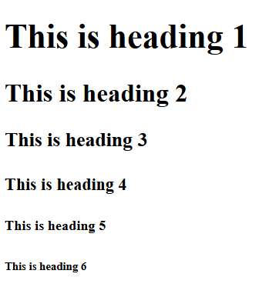
HTML Headings
HTML headings are defined with the <h1> to <h6> tags.
<h1> defines the most important heading. <h6> defines the least important heading:
<!DOCTYPE html>
<html>
<body>
<h1>This is heading 1</h1>
<h2>This is heading 2</h2>
<h3>This is heading 3</h3>
<h4>This is heading 4</h4>
<h5>This is heading 5</h5>
<h6>This is heading 6</h6>
</body>
</html>

Slide 7
Paragraph
HTML paragraphs are defined with <p> tags
<!DOCTYPE html>
<html>
<body>
<p>This is a paragraph.</p>
<p>This is another paragraph.</p>
</body>
</html>
This is a paragraph.
This is another paragraph.

Slide 8
Image tag
<IMG> - Will display an image
  Image file must be in a popular graphics format (gif, jpg, png, etc)
  Format :
<IMG src=“url for image file” width=#, height=#, alt=“Text to display”>

Slide 9
Font Styles
Style information can be included in tags with the ‘style=‘ attribute
Format : <tag style=“attr1:value1; attr2:value2”> text text text </tag>
  attr1 and attr2 are style property names
  value1 and value2 are values to attach to the properties
Most common style attributes:
  background-color for background color
  color for text colors
  font-family for text fonts
  font-size for text sizes
  text-align for text alignment
<p style=“background-color:red; color=black”>Paragraph text. </p>
Using CSS (Cascading Style Sheets) is actually much easier and less error prone

Slide 10
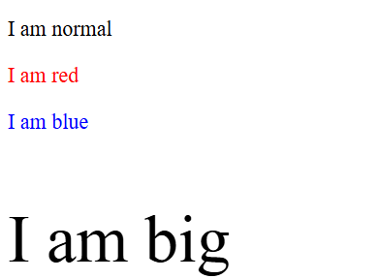
Font styles
The HTML style attribute is used to add styles to an element, such as color, font, size, and more.
<!DOCTYPE html>
<html>
<body>
<p>I am normal</p>
<p style="color:red;">I am red</p>
<p style="color:blue;">I am blue</p>
<p style="font-size:50px;">I am big</p>
</body>
</html>

Slide 11
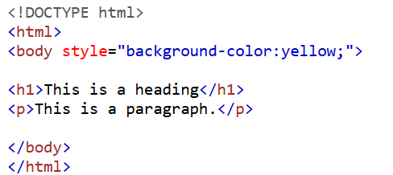
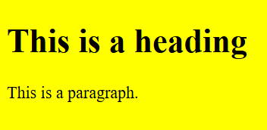
Background Color
The CSS background-color property defines the background color for an HTML element.

Slide 12
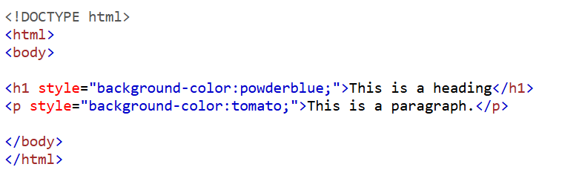
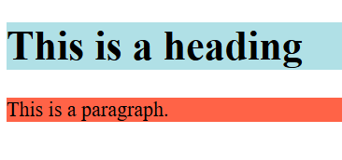
Set background colour for two different elements

Slide 13
Formatting Tags
<b></b> - Bold text
<strong></strong> - Important text (similar to bold)
<i><i> - Italic text
<em></em> - Emphasized text (similar to Italic)
<mark></mark> - Marked text
<small><small> - Small text
<del></del> - Deleted text (stroked text)
<ins></ins> - Inserted text
<sub></sub> - Subscript text
<sup></sup> - Superscript text

Slide 14
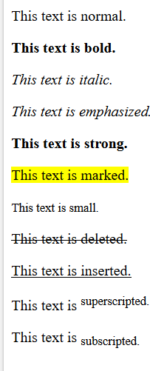
Example: Formatting Tags
<!DOCTYPE html>
<html>
<body>
<p>This text is normal.</p>
<p><b>This text is bold.</b></p>
<p><i>This text is italic.</i></p>
<p><em>This text is emphasized.</em></p>
<p><strong>This text is strong.</strong></p>
<p><mark>This text is marked.</mark></p>
<p><small>This text is small.</small></p>
<p><del>This text is deleted.</del></p>
<p><ins>This text is inserted.</ins></p>
<p>This text is <sup>superscripted.</sup></p>
<p>This text is <sub>subscripted.</sub></p>
</body>
</html>

Slide 15
Links
href attribute
  This can be any URI or local file
    URI should include protocol, server, and path
  Local file can be specified with an absolute or relative path
Content can be text OR an image. Ex:
<A HREF=http://target.com/path/file.html>
<IMG src=“small_pic.jpg”>
</A>
title attribute
  Used to provide descriptive text.
  Text is displayed when cursor is hovered over link

Slide 16
Links
Links – These mark a hyperlink around link text.When click by user, browser loads the page in the HREF attribute.
  Format <A HREF=“url target”>Text for link</A>
    Only ‘Text for link’ will show up on page.
  Target attribute, indicates which window/tab should be used for the linked page
      target=“_self ” – Default. Place the content in the current tab
    target=“_blank” – Place the content in a newly created tab

Slide 17
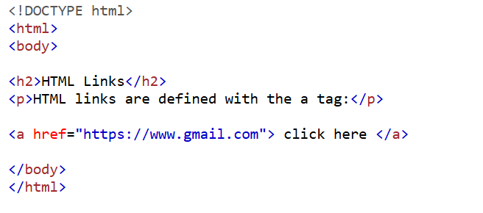
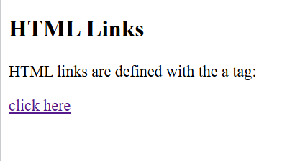
HTML Links
HTML links are defined with the <a> tag

Slide 18
Links
Links can target ‘bookmarks’ created with the id attribute on a tag
Will scroll to the section marked with the named id
some_web_page.html:
…
<h2 id=“MoreStyles”>
…
Inner link:
<A HREF=“#MoreStyles”>Go to MoreStyles section”</A>
From another_web_page.html:
…
<A HREF=http://someserver.com/some_web_page.html#MoreStyles>See info on Styles</A>

Slide 19
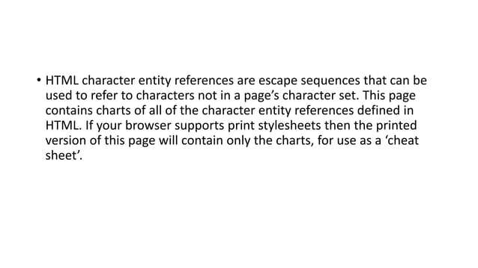

Slide 20
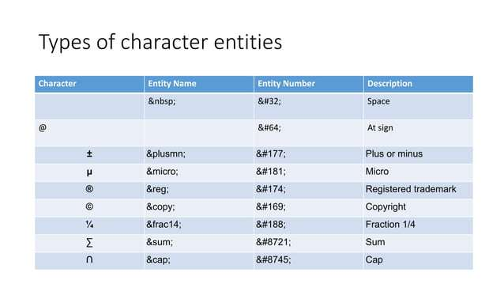

Slide 21
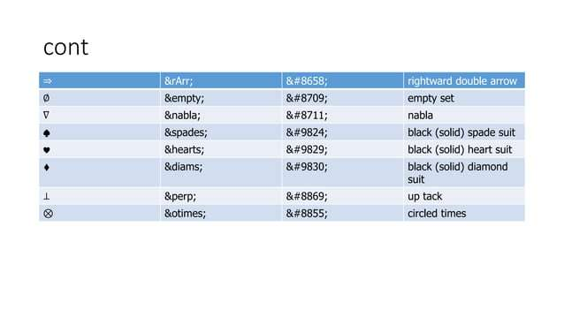

Slide 22
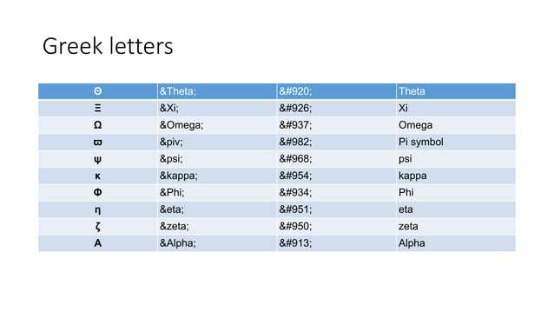

Slide 23
HTML - Lists
  <UL></UL> - Unordered List
  <OL></OL> - Ordered List
    <LI></LI> - Encloses a single list item
  <DL></DL> - Description List
    <dt></dt> - Description Term
    <dd></dd>- Description Details

Slide 24
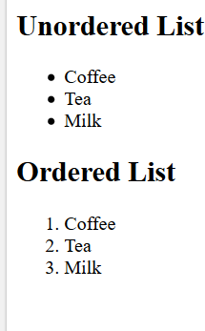
HTML – Example: Lists
<!DOCTYPE html>
<html>
<body>
<h2>Unordered List</h2>
<ul>
<li>Coffee</li>
<li>Tea</li>
<li>Milk</li>
</ul>
<h2>Ordered List</h2>
<ol>
<li>Coffee</li>
<li>Tea</li>
<li>Milk</li>
</ol>
</body>
</html>

Slide 25
HTML – Adding styles to lists
UL takes a style attribute to customize the list
  list-style-type
    circle
    square
    disc
    none

Slide 26
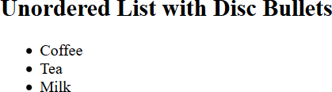
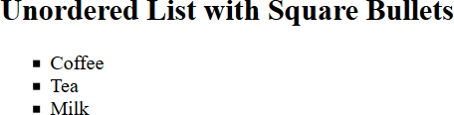
HTML – Example: Styled lists
<!DOCTYPE html>
<html>
<body>
<h2>Unordered List with Disc Bullets</h2>
<ul style="list-style-type:disc;">
<li>Coffee</li>
<li>Tea</li>
<li>Milk</li>
</ul>
</body>
</html>
<!DOCTYPE html>
<html>
<body>
<h2>Unordered List with Square Bullets</h2>
<ul style="list-style-type:square;">
<li>Coffee</li>
<li>Tea</li>
<li>Milk</li>
</ul>
</body>
</html>

Slide 27
HTML - Comments
Comments are contained in ‘<!-- -->
Example:
<!– This is a comment and does not affect rendering of the page at all -->

Slide 28
HTML – Tables
HTML Supports creating tables
  Tags:
    <table></table> - Encloses the entire contents of the table
    <tr></tr> - These bracket a ‘row’ of data cells
    <th></th> - These tags support a row used specifically for column headings
    <td></td> - These tags go around data for a specific cell
    <caption> - This defines a table caption

Slide 29
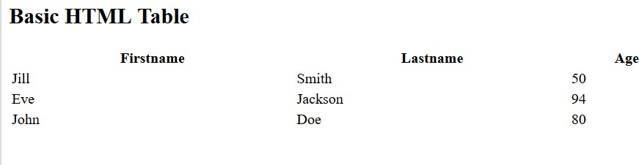
HTML – Example: Tables
<html>
<body>
<tr>
<td>John</td>
<td>Doe</td>
<td>80</td>
</tr>
</table>
<h2>Basic HTML Table</h2>
<table style="width:100%">
<tr>
<th>Firstname</th>
<th>Lastname</th>
<th>Age</th>
</tr>
</body>
</html>
<tr>
<td>Jill</td>
<td>Smith</td>
<td>50</td>
</tr>
<tr>
<td>Eve</td>
<td>Jackson</td>
<td>94</td>
</tr>
23
(

Slide 30
HTML – Forms
Forms can be used to collect data and respond to queries
Tags:
  <form></form> - This encases the entire form
  Forms contain a number of input elements as well as text fields
  There is at least one input to indicate when to submit a form to the back end.
Form tag attributes
  action= - This indicates the script on the server to run when the submit action is selected
  method= - This indicates what ‘HTTP method’ to use (i.e. “GET”, “PUT”, “POST”, etc)
Input Tags within a form:
  <input></input> This encloses input fields of various types based on attributes in the tag

Slide 31
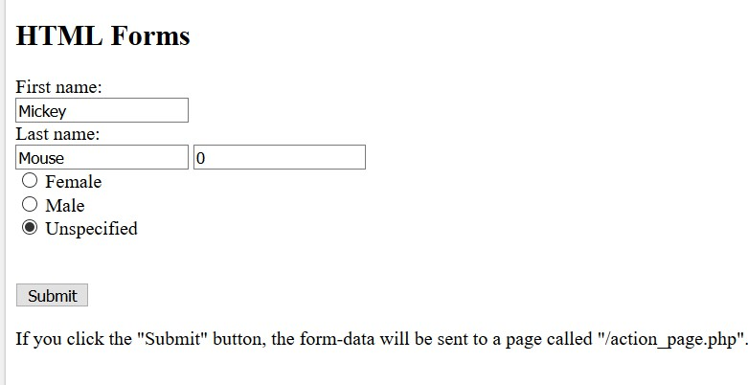
HTML – Example: Forms
<!DOCTYPE html>
<html>
<body>
<h2>HTML Forms</h2>
<form action="/action_page.php"> First name:<br>
<input type="text" name="firstname" value="Mickey">
<br>
Last name:<br>
<input type="text" name="lastname" value="Mouse">
<input type="text" name="age" value="0"><br>
<input type="radio" name="gender"> Female<br>
<input type="radio" name="gender"> Male<br>
<input type="radio" name="gender"> Unspecified<br>
<br><br>
<input type="submit" value="Submit">
</form>
<p>If you click the "Submit" button, the form-data will be sent to a page called "/action_page.php".</p>
</body>
</html>

Slide 32
HTML – Miscellaneous Tags
<pre></pre> - Pre-formatted text Browser will render content as it is written in the html file.
<br> - Add a line break here.There is no </br>
<hr> - Add a ‘horizontal rule’ (horizontal line).
There is no </hr>

Slide 33
Text Properties
Color
Text Alignment
Text Decoration
Text Transformation
Text Indentation

Slide 34
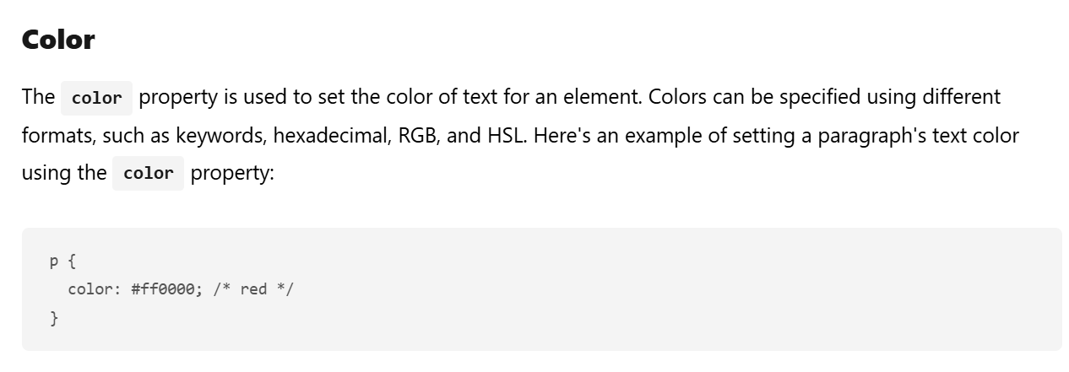

Slide 35
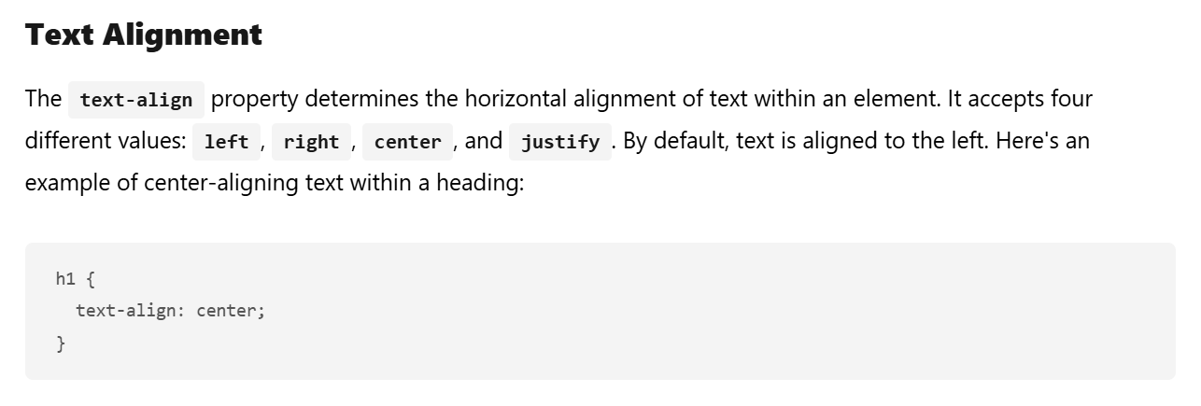

Slide 36
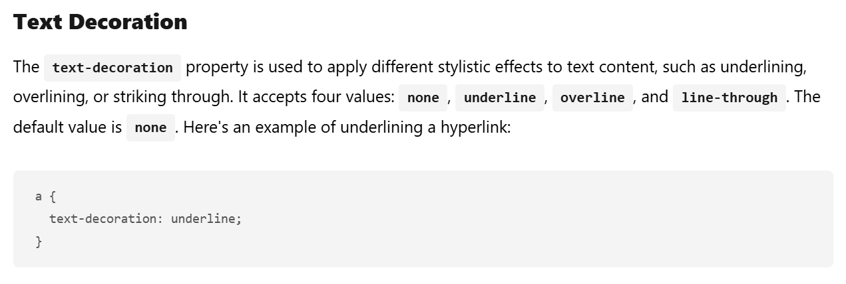

Slide 37
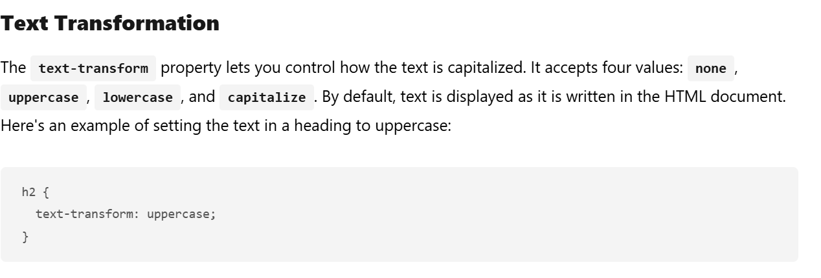

Slide 38
Font Properties
Font Family
Font Size
Font Weight
Font Style
Line Height

Slide 39
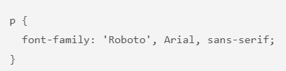
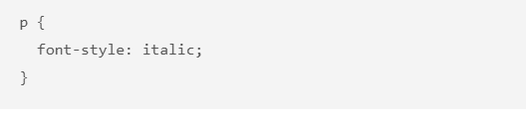
Font Family
Font Style

Slide 40
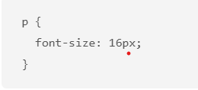
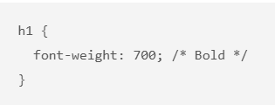
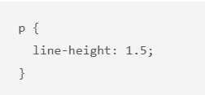
Font Size
Font Weight
Line Height

Slide 41
CSS
CSS = Cascading Style Sheets
Greatly simplifies styling HTML
Easy to keep consistent styling
Instructions are written as a rule-set
27

Slide 42
A brief history of CSS
CSS was first proposed by Håkon Wium Lie on October 10, 1994, and W3C CSS Recommendation (CSS1) was released in 1996.
CSS level 2 specification was developed by the W3C and published as a recommendation in May 1998.
CSS2.1 as finally published as a W3C Recommendation on 7 June 2011.

Slide 43
A brief history of CSS
CSS 3 is divided into several separate documents called "modules" and its notes are posted on
W3C:
css3-background CSS Backgrounds and Borders Module Level 3 Candidate Rec. Oct 2017
css3-box
css-cascade-3
css3-color
css3-content
css-fonts-3
css3-gcpm
css3-layout
css3-mediaqueries Media Queries Recommendation Jun 2012
mediaqueries-4 Media Queries Level 4
css3-multicol
css3-page
selectors-3
selectors-4
css3-ui
CSS basic box model Working Draft CSS Cascading and Inheritance Level 3
Jul 2018
Candidate Rec. May 2016
CSS Color Module Level 3 Recommendation CSS3 Generated and Replaced Content Module
Jun 2018
Working Draft Jun 2016 Sep 2018
Working Draft May 2014
CSS Fonts Module Level 3 Recommendation CSS Generated Content for Paged Media Module
CSS Template Layout Module Note Mar 2015
Candidate Rec. Working Draft Working Draft Nov 2018
Feb 2018
Sep 2017
May 2018
Mar 2013
Multi-column Layout Module Level 1 CSS Paged Media Module Level 3
Selectors Level 3
Selectors Level 4
Recommendation Working Draft
CSS Basic User Interface Module Level 3 (CSS3 UI) Recommendation Jun 2018

Slide 44
A brief history of CSS
There is no single, integrated CSS 4 specification
  The CSS Working Group sometimes publishes "Snapshots", a collection of whole modules and parts of other drafts that are considered stable enough to be implemented by browser developers in 2007, 2010, 2015, 2017,and 2018.

Slide 45
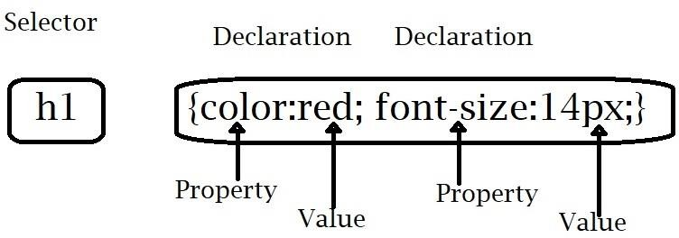
CSS rule-sets
CSS rule-sets have the following format:
Selectors indicate the tag or other element
Property/value pairs give the attribute to define and the value of the attribute
Property/value pairs are separated with a semicolon ;

Slide 46
CSS - Selectors
Selectors can be
  A tag name (i.e. <p>) – This will apply to all tags of that type in the document
  An id (<h2 id=“foo”>) – The style will apply to ANY tag with the named id.
  A class (<p class=“LargeRed”>) The style will
apply to ANY element with the named class)

Slide 47
CSS – Examples: Selectors
p {
text-align: center; color: blue;
}
#C4 {
text-align: left; color: red;
}
.center {
text-align: center; color: green;
}
Applies to all paragraphs in the document
Applies to any tag marked with id=“C4”
Applies to any tag marked with class=“center”

Slide 48
CSS – Selector Grouping
Selectors for elements with the same style can be grouped and use a common style description
h1, h2, p {
text-align: center; color: red;
}

Slide 49
CSS – Placement of CSS Information
CSS style information can be put in one of three places:
  External sheet
    Can be used for an entire website
    Each .html file must reference same sheet
  Internal sheet
    Can be used to consistently style 1 html page
  Inline styles

Slide 50
CSS – External Style Sheets
my_site_style.css:
a_web_page.html:
body {
background-color: lightblue;
}
<html>
<head>
<link rel="stylesheet" type="text/css" href="my_site_style.css">
</head>
<body>
…
</body>
</html>
h1 {
color: navy; margin-left: 20px;
}
Separate file holding style information
References the file with style information

Slide 51
CSS – Internal Style Sheets
<html>
<head>
<style> body {
background-color: linen;
}
h1 {
color: maroon; margin-left: 40px;
}
</style>
</head>
<body>
…
</body>
</html>
All style information enclosed in <style> tag within the <head> of an html document

Slide 52
CSS – Local Inline styles
Style info can be placed inside any tag (as has been seen earlier)
Ex: <h1 style=“color:red; text-size:14px;”>

Slide 53
CSS – Cascading Order
With a mix of internal, external, and inline style information, the styles will be applied by building a ‘virtual’ style sheet considering each style specification in the following priority order:
  Inline style (inside an HTML element)
  External and internal style sheets (in the head section using order of links/style sections in the head)
  More specific selectors are selected
    For example, if we have a style for <p> and a style for id1, then the style of <p id=id1> will be the style of id1

Slide 54
CSS – Style Attributes
Colors
Backgrounds
Borders
Margins
Padding
Height/Width

Slide 55
CSS - Colors
Colors can be specified as:
  A color name like ‘red’, ‘lightblue’, etc
    HTML supports 140 standard color names
  A hex value : #ff0000, #000066, etc.
    Rgb values
    2 hex ‘nibbles’ per color giving ranges of 0-255 for each
  An RGB value like: rgb(255,0,0)
    Same as hex values but with decimal numbers
Example:
  h1 {color:green;}
  p {color: red;}

Slide 56
CSS – Backgrounds
Elements can have different backgrounds
  Colors
  Images

Slide 57
CSS – Background Color
Attribute: background-color
Value: description of colors
  h1 {background-color: green;}
  div {background-color: #777700;}
    div is just used to divide the page into subsections - no other structural effect on the page

Slide 58
CSS – Background Images
Attribute: background-image
Value is usually a URL of a graphic file
Example:
  body {background-image: URL(“mountain.jpg”)}
Images can be positioned within an element
  Attribute: background-position:
  Value: (horizontal and vertical positioning (left, center, right, bottom, center, top))
  Example:
<!—place image starting in the upper right corner of the page’s body -->
body {background-image: URL(“mountain.jpg”); background-position: right top}

Slide 59
CSS – Background Images
Images can be repeated if two small to cover an area
  Attribute: background-repeat
  Values:
    repeat-x – repeat horizontally across area
    repeat-y – repeat vertically down area
    no-repeat – do not repeat image
Images can scroll with page:
  Background-attachment:scroll
Can specify all attributes using ‘background:’
  Values for background must be in this order:
    background-color
    background-image
    background-repeat
    background-attachment
    background-position
    Example:
body {background: URL(“mountain.jpg”) repeat-x scroll right top}
(

Slide 60
CSS - Borders
CSS allows specification of the style, width and color of element borders
Attributes:
  border-style : style keyword – includes dotted, dashed, solid, double, groove, ridge, inset, outset, none, hidden}
    One value – Applies to all 4 sides
    Two values – 1st applies to top and bottom, 2nd applies to left and right
    Three values – 1st applies to top, 2nd applies to left and right, 3rd applies to bottom
    Four values – Values applied as top, right, bottom, left
  border-width :
    Value can be specified in pt, px, cm, em
    Value can use one of 3 keywords: thin, medium, thick
  border-color
    Values: See Colors earlier in this talk

Slide 61
CSS - Borders
Shorthands:
  border-left-style, border-right-style, border- top-style, border-bottom-style
  Same for border-x-width and border-x-color
  border: handles all 3 attributes in order:
    width
    style (required)
    color
  Example:
    h1 {border: 5px solid orange}

Slide 62
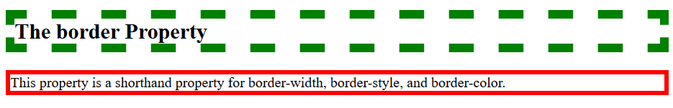
CSS - Borders
<!DOCTYPE html>
<html>
<head>
<style>
h2 { border: 10px dashed green;} p { border: 5px solid red;}
</style>
</head>
<body>
<h2>The border Property</h2>
<p>This property is a shorthand property for border-width, border-style, and border-color.</p>
</body>
</html>

Slide 63
CSS - Margins
Attribute: margin
Margin gives spacing outside the ‘border’ of an element
Similar to border, margin has separate attributes for left, top, bottom, and right sides
Values:
  auto – browser calculates margin
  A length in px, pt, cm, etc
  % - margin is a percentage of the width of the containing element
  Inherit – Margin is inherited from parent element
margin can also have 4, 3, 2, or 1 value(s). Application pattern similar to border.

Slide 64
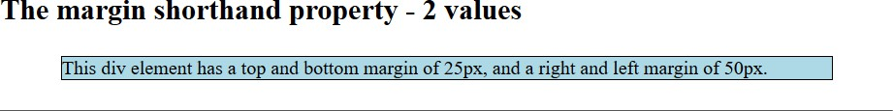
CSS – Example: Margin
<!DOCTYPE html>
<html>
<head>
<style> div {
border: 1px solid black; margin: 25px 50px; background-color: lightblue;
}
</style>
</head>
<body>
<h2>The margin shorthand property - 2 values</h2>
<div>This div element has a top and bottom margin of 25px, and a right and left margin of 50px.</div>
<hr>
</body>
</html>

Slide 65
CSS - Padding
Padding generates space around an element but within its border
Attributes: padding, padding-left, padding-top, padding- bottom, padding-right
Values:
  Length – A length value in pt, px, cm, em, etc
  % - A percentage of the width of the element
  inherit – The padding is inherited from parent element

Slide 66
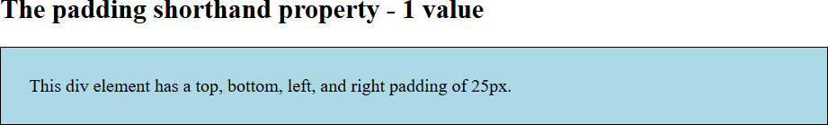
CSS – Example: Padding
<!DOCTYPE html>
<html>
<head>
<style>
div { border: 1px solid black; padding: 25px;
background-color: lightblue; }
</style>
</head>
<body>
<h2>The padding shorthand property - 1 value</h2>
<div>This div element has a top, bottom, left, and right padding of 25px.</div>
</body>
</html>

Slide 67
CSS – Height/Width
These attributes give the height and width of an element
Default value is auto which lets the browser figure out the best size
Values can be specified as:
  A length – in pt, px, cm, etc.
  A percentage of the containing block

Slide 68
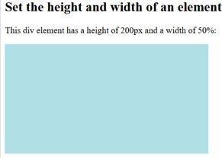
CSS – Example: Height/Width
<!DOCTYPE html>
<html>
<head>
<style>
div { height: 200px; width: 50%;
background-color: powderblue; }
</style>
</head>
<body>
<h2>Set the height and width of an element</h2>
<p>This div element has a height of 200px and a width of 50%:</p>
<div></div>
</body>
</html>
54
(

Slide 69
CSS – The Box Model
CSS Box Model refers to the layout of an element including margin, borders, padding, and content
  Content: The content of the element
  Padding: area around the content and within the border. Padding is transparent
  Border: A border that surrounds the element and padding
  Margin: Area outside the border. Margin is transparent.

Slide 70

CSS – Box Model

Slide 71
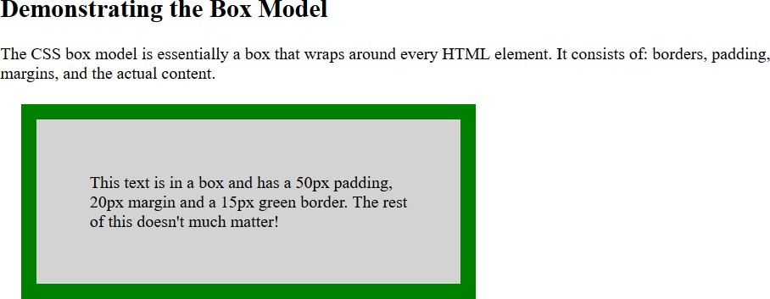
CSS – Example: Box Model
<!DOCTYPE html>
<html>
<head>
<style>
div { background-color: lightgrey; width: 300px;
border: 15px solid green; padding: 50px;
margin: 20px; }
</style>
</head>
<body>
<h2>Demonstrating the Box Model</h2>
<p>The CSS box model is essentially a box that wraps around every HTML element. It consists of: borders, padding, margins, and the actual content.</p>
<div>This text is in a box and has a 50px padding, 20px margin and a 15px green border. The rest of this doesn't much matter!</div>
</body>
</html>

Slide 72
CSS – Styles for Links
Links can be styled using any CSS attributes (color, background-color, text-decoration, font-family, font-size, background, etc)
Links can have different styling based on their ‘state’. 4 states are:
  :link – An unvisited link
  :visited – A link that has been visited
  :hover – A link when the cursor os hovering over it
  :active – A link when the left mouse button is depressed over it
Ordering is important! If all 4 states have styles
  hover must be after link and visited
  active must follow hover

Slide 73


CSS – Example: Link Styles
<!DOCTYPE html>
<html>
<head>
When left button depressed on link
<style>
a:link { text-decoration: none; }
a:visited { text-decoration: none; color: green; } a:hover { text-decoration: underline; color: red; } a:active { text-decoration: underline; color: hotpink; }
</style>
</head>
<body>
<p><b><a href="default.asp" target="_blank">This is a link</a></b></p>
<p>Misc other text</p>
</body>
</html>
After visiting link

Slide 74
CSS – Styles for Lists
Unordered list: list-style-type
  Circle
  Square
  Disc
Ordered list: list-style-type
  Upper-roman
  Lower-roman
  Upper-alpha
  Lower-alpha
  Other: https://www.w3schools.com/cssref/pr_list-style-type.asp

Slide 75
CSS – Styles for Lists
Attribute: list-style-position (shorthand attribute: list-style)
  Inside – bullet or marker is pulled in with text (so inside border)
  Outside – bullet or marker is left outside element’s
border (out-hanging)

Slide 76
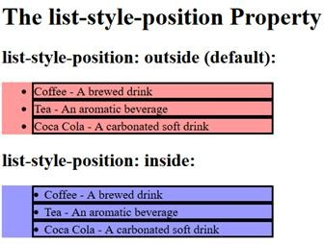
CSS – Example: Styles for Lists
<!DOCTYPE html>
<html>
<head>
<style>
li {border: solid;}
ul.a { list-style-position: outside; background: #ff9999; } ul.b { list-style-position: inside; background: #9999ff; }
</style>
</head>
<body>
<h1>The list-style-position Property</h1>
<h2>list-style-position: outside (default):</h2>
<ul class="a">
<li>Coffee - A brewed drink</li>
<li>Tea - An aromatic beverage </li>
<li>Coca Cola - A carbonated soft drink</li>
</ul>
<h2>list-style-position: inside:</h2>
<ul class="b">
<li>Coffee - A brewed drink</li>
<li>Tea - An aromatic beverage </li>
<li>Coca Cola - A carbonated soft drink</li>
</ul>
</body>
</html>

Slide 77
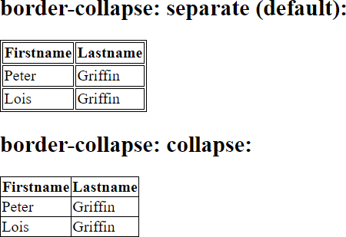
CSS – Styles for Tables
Various table elements can take on properties like border, padding, text-align, width, height and others
  border
  width
  text-align
  border-collapse

Slide 78
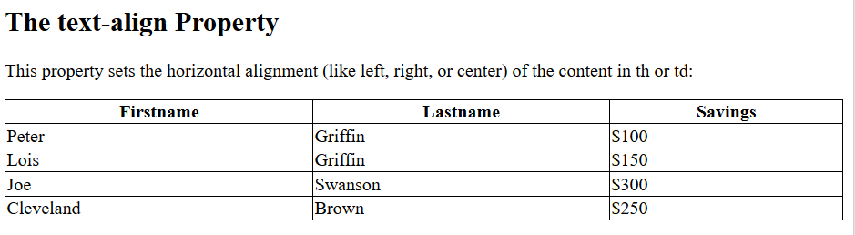
CSS – Example: Table Styling
<!DOCTYPE html>
<html>
<head>
<style> table, td, th {
border: 1px solid black;
}
table {
border-collapse: collapse; width: 100%;
}
th {
text-align: center;
}
</style>
</head>
<body>
<h2>The text-align Property</h2>
<p>This property sets the horizontal alignment (like left,
right, or center) of the content in th or td:</p>
<table>
<tr>
<tr>
<td>Peter</td>
<td>Griffin</td>
<td>$100</td>
</tr>
<tr>
<td>Lois</td>
<td>Griffin</td>
<td>$150</td>
</tr>
<tr>
<td>Joe</td>
<td>Swanson</td>
<td>$300</td>
</tr>
<tr>
<td>Cleveland</td>
<td>Brown</td>
<td>$250</td>
</tr>
</table>
</body>
</html>
<th>Firstname</th>
<th>Lastname</th>
<th>Savings</th>
</tr>
64
(

Slide 79
Summary
HTML – Hyper Text Markup Language
  Used to describe most web page content
  Static – no ‘execution’ semantics
C// – Cascading Style Sheets
  Help customize look and feel of web pages
  Numerous ways to address elements and groups of elements
  Varied properties to produce rich styling
Next Lecture:
  JavaScript
65
(

